Slide 1


Hadoop, a distributed framework for Big Data

Slide 2

Introduction
Introduction: Hadoop’s history and advantages
Architecture in detail
Hadoop in industry

Slide 3
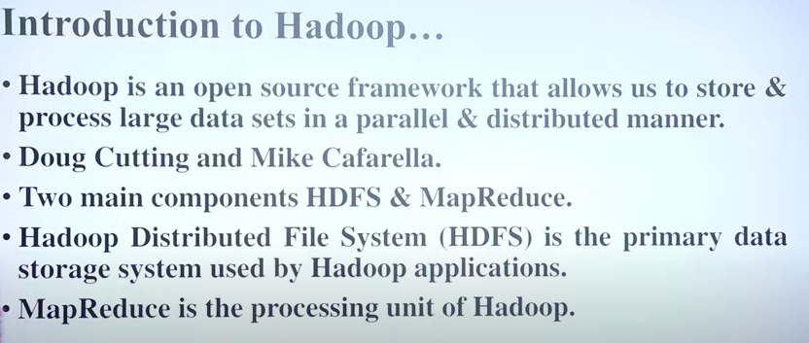

Slide 4

What is Hadoop?
Apache top level project, open-source implementation of frameworks for reliable, scalable, distributed computing and data storage.
It is a flexible and highly-available architecture for large scale computation and data processing on a network of commodity hardware.

Slide 5
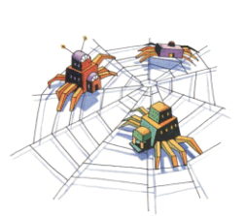
Brief History of Hadoop
Designed to answer the question: “How to process big data with reasonable cost and time?”

Slide 6
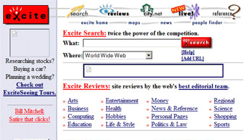
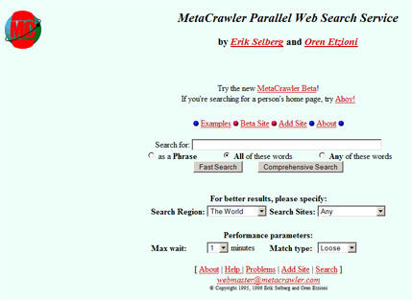


Search engines in 1990s
1996
1996
1996
1997

Slide 7
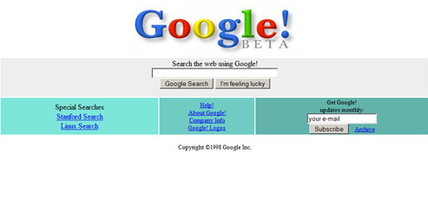

Google search engines
1998
2013

Slide 8




Hadoop’s Developers
2005: Doug Cutting and Michael J. Cafarella developed Hadoop to support distribution for the Nutch search engine project.
The project was funded by Yahoo.
2006: Yahoo gave the project to Apache
Software Foundation.
Doug Cutting

Slide 9
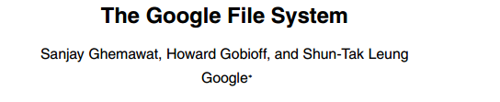

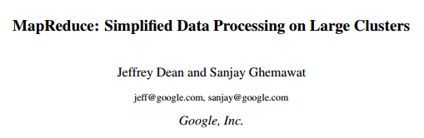


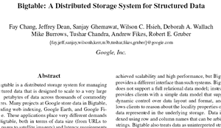
Google Origins
2003
2004
2006

Slide 10
Some Hadoop Milestones
2008 - Hadoop Wins Terabyte Sort Benchmark (sorted 1 terabyte of data in 209 seconds, compared to previous record of 297 seconds)
2009 - Avro and Chukwa became new members of Hadoop Framework family
2010 - Hadoop's Hbase, Hive and Pig subprojects completed, adding more computational power to Hadoop framework
2011 - ZooKeeper Completed
2013 - Hadoop 1.1.2 and Hadoop 2.0.3 alpha.
- Ambari, Cassandra, Mahout have been added

Slide 11
What is Hadoop?
Hadoop:
an open-source software framework that supports data-intensive distributed applications, licensed under the Apache v2 license.
Goals / Requirements:
Abstract and facilitate the storage and processing of large and/or rapidly growing data sets
Structured and non-structured data
Simple programming models
High scalability and availability
Use commodity (cheap!) hardware with little redundancy
Fault-tolerance
Move computation rather than data

Slide 12
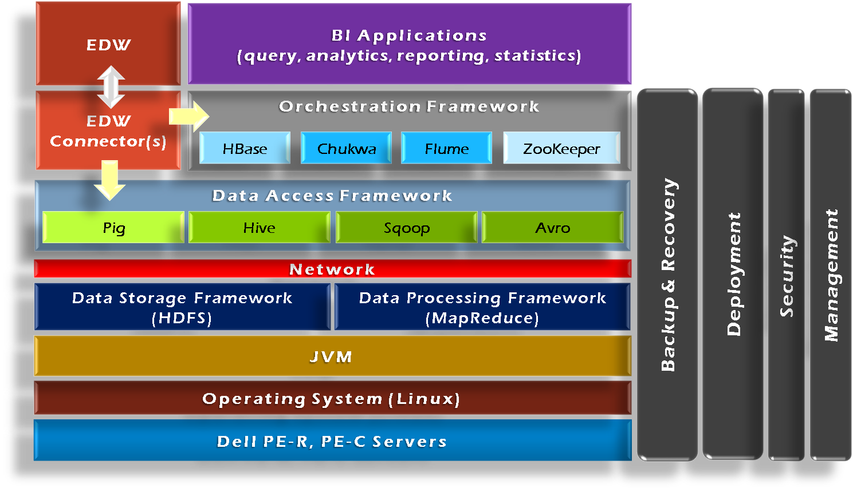
Hadoop Framework Tools

Slide 13
Hadoop’s Architecture
Distributed, with some centralization
Main nodes of cluster are where most of the computational power and storage of the system lies
Main nodes run TaskTracker to accept and reply to MapReduce tasks, and also DataNode to store needed blocks closely as possible
Central control node runs NameNode to keep track of HDFS directories & files, and JobTracker to dispatch compute tasks to TaskTracker
Written in Java, also supports Python and Ruby

Slide 14
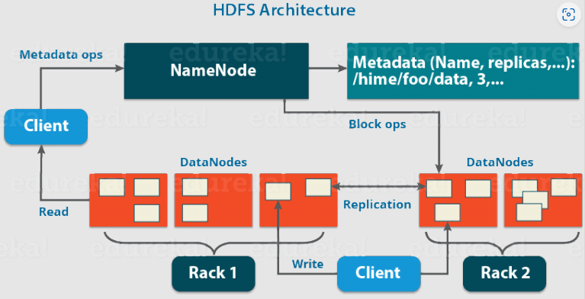
Hadoop’s Architecture

Slide 15
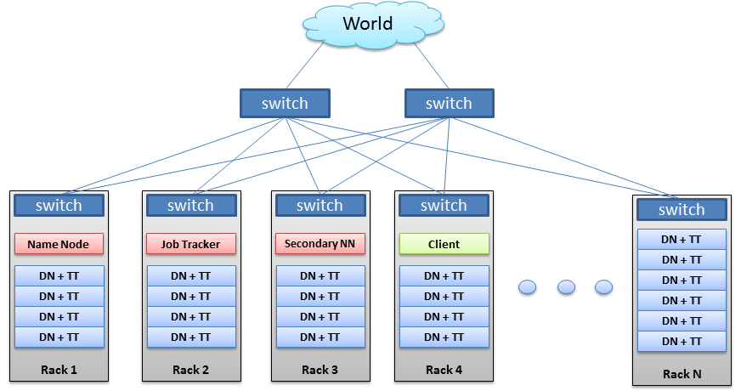
Hadoop’s Architecture

Slide 16
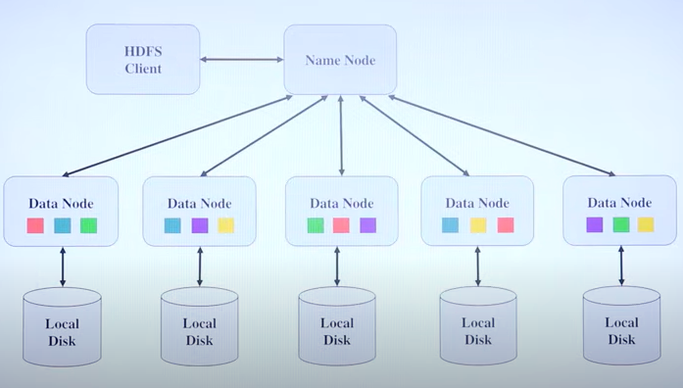
HDFS

Slide 17
Hadoop’s Architecture
Hadoop Distributed Filesystem
Tailored to needs of MapReduce
Targeted towards many reads of filestreams
Writes are more costly
High degree of data replication (3x by default)
No need for RAID on normal nodes
Large blocksize (64MB)
Location awareness of DataNodes in network

Slide 18
Hadoop’s Architecture
NameNode:
Stores metadata for the files, like the directory structure of a typical FS.
The server holding the NameNode instance is quite crucial, as there is only one.
Transaction log for file deletes/adds, etc. Does not use transactions for whole blocks or file-streams, only metadata.
Handles creation of more replica blocks when necessary after a DataNode failure

Slide 19
Hadoop’s Architecture
DataNode:
Stores the actual data in HDFS
Can run on any underlying filesystem (ext3/4, NTFS, etc)
Notifies NameNode of what blocks it has
NameNode replicates blocks 2x in local rack, 1x elsewhere

Slide 20
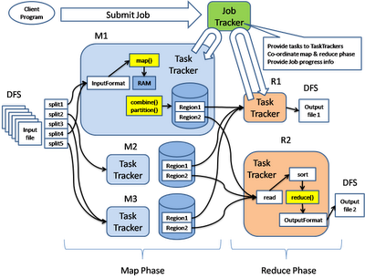
Hadoop’s Architecture: MapReduce Engine

Slide 21
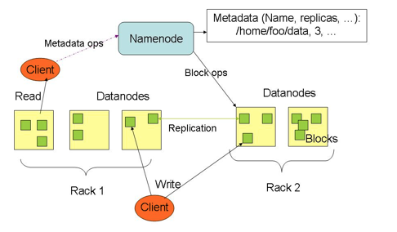

Slide 22
Hadoop’s Architecture
MapReduce Engine:
JobTracker & TaskTracker
JobTracker splits up data into smaller tasks(“Map”) and sends it to the TaskTracker process in each node
TaskTracker reports back to the JobTracker node and reports on job progress, sends data (“Reduce”) or requests new jobs

Slide 23
Hadoop’s Architecture
None of these components are necessarily limited to using HDFS
Many other distributed file-systems with quite different architectures work
Many other software packages besides Hadoop's MapReduce platform make use of HDFS

Slide 24
Hadoop in the Wild
Hadoop is in use at most organizations that handle big data:
Yahoo!
Facebook
Amazon
Netflix
Etc…
Some examples of scale:
Yahoo!’s Search Webmap runs on 10,000 core Linux cluster and powers Yahoo! Web search
FB’s Hadoop cluster hosts 100+ PB of data (July, 2012) & growing at ½ PB/day (Nov, 2012)

Slide 25
Hadoop in the Wild
Three main applications of Hadoop:
Advertisement (Mining user behavior to generate recommendations)
Searches (group related documents)
Security (search for uncommon patterns)

Slide 26
Hadoop in the Wild
Non-realtime large dataset computing:
NY Times was dynamically generating PDFs of articles from 1851-1922
Wanted to pre-generate & statically serve articles to improve performance
Using Hadoop + MapReduce running on EC2 / S3, converted 4TB of TIFFs into 11 million PDF articles in 24 hrs

Slide 27

Hadoop in the Wild: Facebook Messages
Design requirements:
Integrate display of email, SMS and chat messages between pairs and groups of users
Strong control over who users receive messages from
Suited for production use between 500 million people immediately after launch
Stringent latency & uptime requirements

Slide 28

Hadoop in the Wild
System requirements
High write throughput
Cheap, elastic storage
Low latency
High consistency (within a single data center good enough)
Disk-efficient sequential and random read performance

Slide 29
Hadoop in the Wild
Classic alternatives
These requirements typically met using large MySQL cluster & caching tiers using Memcached
Content on HDFS could be loaded into MySQL or Memcached if needed by web tier
Problems with previous solutions
MySQL has low random write throughput… BIG problem for messaging!
Difficult to scale MySQL clusters rapidly while maintaining performance
MySQL clusters have high management overhead, require more expensive hardware

Slide 30
Hadoop in the Wild
Facebook’s solution
Hadoop + HBase as foundations
Improve & adapt HDFS and HBase to scale to FB’s workload and operational considerations
Major concern was availability: NameNode is SPOF & failover times are at least 20 minutes
Proprietary “AvatarNode”: eliminates SPOF, makes HDFS safe to deploy even with 24/7 uptime requirement
Performance improvements for realtime workload: RPC timeout. Rather fail fast and try a different DataNode

Slide 31
Hadoop Highlights
Distributed File System
Fault Tolerance
Open Data Format
Flexible Schema
Queryable Database

Slide 32
Why use Hadoop?
Need to process Multi Petabyte Datasets
Data may not have strict schema
Expensive to build reliability in each application
Nodes fails everyday
Need common infrastructure
Very Large Distributed File System
Assumes Commodity Hardware
Optimized for Batch Processing
Runs on heterogeneous OS

Slide 33
DataNode
A Block Sever
Stores data in local file system
Stores meta-data of a block - checksum
Serves data and meta-data to clients
Block Report
Periodically sends a report of all existing blocks to NameNode
Facilitate Pipelining of Data
Forwards data to other specified DataNodes

Slide 34
Block Placement
Replication Strategy
One replica on local node
Second replica on a remote rack
Third replica on same remote rack
Additional replicas are randomly placed
Clients read from nearest replica

Slide 35
Data Correctness
Use Checksums to validate data – CRC32
File Creation
Client computes checksum per 512 byte
DataNode stores the checksum
File Access
Client retrieves the data and checksum from DataNode
If validation fails, client tries other replicas

Slide 36
Data Pipelining
Client retrieves a list of DataNodes on which to place replicas of a block
Client writes block to the first DataNode
The first DataNode forwards the data to the next DataNode in the Pipeline
When all replicas are written, the client moves on to write the next block in file

Slide 37
Hadoop MapReduce
MapReduce programming model
Framework for distributed processing of large data sets
Pluggable user code runs in generic framework
Common design pattern in data processing
cat * | grep | sort | uniq -c | cat > file
input | map | shuffle | reduce | output

Slide 38
MapReduce Usage
Log processing
Web search indexing
Ad-hoc queries

Slide 39
Closer Look
MapReduce Component
JobClient
JobTracker
TaskTracker
Child
Job Creation/Execution Process

Slide 40
MapReduce Process (org.apache.hadoop.mapred)
JobClient
Submit job
JobTracker
Manage and schedule job, split job into tasks
TaskTracker
Start and monitor the task execution
Child
The process that really execute the task

Slide 41
Inter Process Communication IPC/RPC (org.apache.hadoop.ipc)
Protocol
JobClient <-------------> JobTracker
TaskTracker <------------> JobTracker
TaskTracker <-------------> Child
JobTracker impliments both protocol and works as server in both IPC
TaskTracker implements the TaskUmbilicalProtocol; Child gets task information and reports task status through it.
JobSubmissionProtocol
InterTrackerProtocol
TaskUmbilicalProtocol

Slide 42
JobClient.submitJob - 1
Check input and output, e.g. check if the output directory is already existing
job.getInputFormat().validateInput(job);
job.getOutputFormat().checkOutputSpecs(fs, job);
Get InputSplits, sort, and write output to HDFS
InputSplit[] splits = job.getInputFormat().
getSplits(job, job.getNumMapTasks());
writeSplitsFile(splits, out); // out is $SYSTEMDIR/$JOBID/job.split

Slide 43
JobClient.submitJob - 2
The jar file and configuration file will be uploaded to HDFS system directory
job.write(out); // out is $SYSTEMDIR/$JOBID/job.xml
JobStatus status = jobSubmitClient.submitJob(jobId);
This is an RPC invocation, jobSubmitClient is a proxy created in the initialization

Slide 44
Job initialization on JobTracker - 1
JobTracker.submitJob(jobID) <-- receive RPC invocation request
JobInProgress job = new JobInProgress(jobId, this, this.conf)
Add the job into Job Queue
jobs.put(job.getProfile().getJobId(), job);
jobsByPriority.add(job);
jobInitQueue.add(job);

Slide 45
Job initialization on JobTracker - 2
Sort by priority
resortPriority();
compare the JobPrioity first, then compare the JobSubmissionTime
Wake JobInitThread
jobInitQueue.notifyall();
job = jobInitQueue.remove(0);
job.initTasks();

Slide 46
JobInProgress - 1
JobInProgress(String jobid, JobTracker jobtracker, JobConf default_conf);
JobInProgress.initTasks()
DataInputStream splitFile = fs.open(new Path(conf.get(“mapred.job.split.file”)));
// mapred.job.split.file --> $SYSTEMDIR/$JOBID/job.split

Slide 47
JobInProgress - 2
splits = JobClient.readSplitFile(splitFile);
numMapTasks = splits.length;
maps[i] = new TaskInProgress(jobId, jobFile, splits[i], jobtracker, conf, this, i);
reduces[i] = new TaskInProgress(jobId, jobFile, splits[i], jobtracker, conf, this, i);
JobStatus --> JobStatus.RUNNING

Slide 48
JobTracker Task Scheduling - 1
Task getNewTaskForTaskTracker(String taskTracker)
Compute the maximum tasks that can be running on taskTracker
int maxCurrentMap Tasks = tts.getMaxMapTasks();
int maxMapLoad = Math.min(maxCurrentMapTasks, (int)Math.ceil(double) remainingMapLoad/numTaskTrackers));

Slide 49
JobTracker Task Scheduling - 2
int numMaps = tts.countMapTasks(); // running tasks number
If numMaps < maxMapLoad, then more tasks can be allocated, then based on priority, pick the first job from the jobsByPriority Queue, create a task, and return to TaskTracker
Task t = job.obtainNewMapTask(tts, numTaskTrackers);

Slide 50
Start TaskTracker - 1
initialize()
Remove original local directory
RPC initialization
TaskReportServer = RPC.getServer(this, bindAddress, tmpPort, max, false, this, fConf);
InterTrackerProtocol jobClient = (InterTrackerProtocol) RPC.waitForProxy(InterTrackerProtocol.class, InterTrackerProtocol.versionID, jobTrackAddr, this.fConf);

Slide 51
Start TaskTracker - 2
run();
offerService();
TaskTracker talks to JobTracker with HeartBeat message periodically
HeatbeatResponse heartbeatResponse = transmitHeartBeat();

Slide 52
Run Task on TaskTracker - 1
TaskTracker.localizeJob(TaskInProgress tip);
launchTasksForJob(tip, new JobConf(rjob.jobFile));
tip.launchTask(); // TaskTracker.TaskInProgress
tip.localizeTask(task); // create folder, symbol link
runner = task.createRunner(TaskTracker.this);
runner.start(); // start TaskRunner thread

Slide 53
Run Task on TaskTracker - 2
TaskRunner.run();
Configure child process’ jvm parameters, i.e. classpath, taskid, taskReportServer’s address & port
Start Child Process
runChild(wrappedCommand, workDir, taskid);

Slide 54
Child.main()
Create RPC Proxy, and execute RPC invocation
TaskUmbilicalProtocol umbilical = (TaskUmbilicalProtocol) RPC.getProxy(TaskUmbilicalProtocol.class, TaskUmbilicalProtocol.versionID, address, defaultConf);
Task task = umbilical.getTask(taskid);
task.run(); // mapTask / reduceTask.run

Slide 55
Finish Job - 1
Child
task.done(umilical);
RPC call: umbilical.done(taskId, shouldBePromoted)
TaskTracker
done(taskId, shouldPromote)
TaskInProgress tip = tasks.get(taskid);
tip.reportDone(shouldPromote);
taskStatus.setRunState(TaskStatus.State.SUCCEEDED)

Slide 56
Finish Job - 2
JobTracker
TaskStatus report: status.getTaskReports();
TaskInProgress tip = taskidToTIPMap.get(taskId);
JobInProgress update JobStatus
tip.getJob().updateTaskStatus(tip, report, myMetrics);
One task of current job is finished
completedTask(tip, taskStatus, metrics);
If (this.status.getRunState() == JobStatus.RUNNING && allDone) {this.status.setRunState(JobStatus.SUCCEEDED)}

Slide 57
Demo
Word Count
hadoop jar hadoop-0.20.2-examples.jar wordcount <input dir> <output dir>
Hive
hive -f pagerank.hive

